Slide 1
Kerberos Basics
Dennis Hu (dennhu@micosoft.com)
Senior SEE

Slide 2
Authentication

Slide 3
Authentication
A process for verifying the identity of something or someone.
Occurs before authorization

Slide 4
How authentication works
Something you know: a password or PIN.
Something you have: a phone, credit card or hardware token.
Something you are: a fingerprint, retinal scan or other biometric.
MFA/2FA: 2 factors combined

Slide 5
Something you know?
Something (secret) only you and the other party (or some authority which both trust) know
Some way to prove it to the other party (perhaps via the authority) that you really know the secret
Need to prove it securely
Many protocols in this category

Slide 6
Kerberos

Slide 7
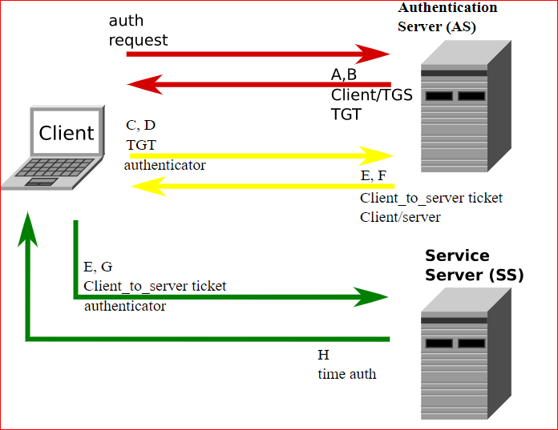
Flow
AS
TGS
AP

Slide 8
SPN
Service Principal Name, to uniquely identify the service
Registered under the security principal (user, computer, or mSA account object) of the service.
Registered by the server-side application, and referenced by the client-side application.
KDC: SPN -> Account -> Password -> Encrypt Ticket Server: Service -> Running context -> Password -> Decrypt Ticket

Slide 9
TGS & AP (In theory)
Client sends a request to the KDC, including its account info and the target service SPN.
Upon request, KDC generates a session key for authentication between the requestor (client) and the requested service (server).
KDC sends the session key to the client, encrypted with the client’s password. So only the client can decrypt it to get the session key.
KDC also encrypts the session key with the server’s password and put it in a Ticket. KDC sends the ticket to the client. Client has no way to decrypt the Ticket. Only the server can decrypt it.
Client uses the session key to encrypt something, such as a timestamp, to generate an Authenticator. Client sends the Authenticator and Ticket to the server.
Server decrypts the Ticket by its password, gets the session key, and then uses the session key to decrypt the Authenticator. If the above flow completes successfully, the client is authenticated at the server.

Slide 10
TGT
Concern: it’s not efficient for the KDC to retrieve the account’s password each time.
KDC is a service as well, the service to issue Tickets.
TGT: the ticket to get service from KDC, being issued after successful authentication.
Benefit: KDC doesn’t need to maintain the session keys between it and each client. It’s the client’s responsibility to maintain and present its TGT. KDC just needs to use its own password to decrypt the TGT and then retrieve the session key, the same way as the server to decrypt the ticket by its own password.

Slide 11
TGS & AP (Actually)
Client sends a request to the KDC, including its account info and the target service SPN, and its TGT.
Upon request, KDC generates a session key for the authentication between the requestor (client) and the requested service (server).
KDC sends the session key to the client, encrypted with the session key between it and the client. KDC gets the session key from the TGT it received from the client. Only the client can decrypt it to get the session key.
KDC also encrypts the session key with the server’s password and put it in a Ticket. KDC sends the ticket to the client. Client has no way to decrypt the Ticket. Only the server can decrypt it.
Client uses the session key to encrypt something, such as a timestamp, to generate an Authenticator. Client sends the Authenticator and Ticket to the server.
Server decrypts the Ticket by its password, gets the session key, and then uses the session key to decrypt the Authenticator. If the above flow completes successfully, the client is authenticated at the server.

Slide 12
AS
The interaction between the client and the KDC to get the TGT.
The way the client gets authenticated in Kerberos. (What if a client get a TGT which belongs to another account?)
KDC: the service issue TGT
KRBTGT: the SPN of KDC service

Slide 13
Complex issues
Cross-domain
Krbtgt/A.com -> krbtgt/B.com -> service@B.com
Delegation - on behalf of another identity

Slide 14
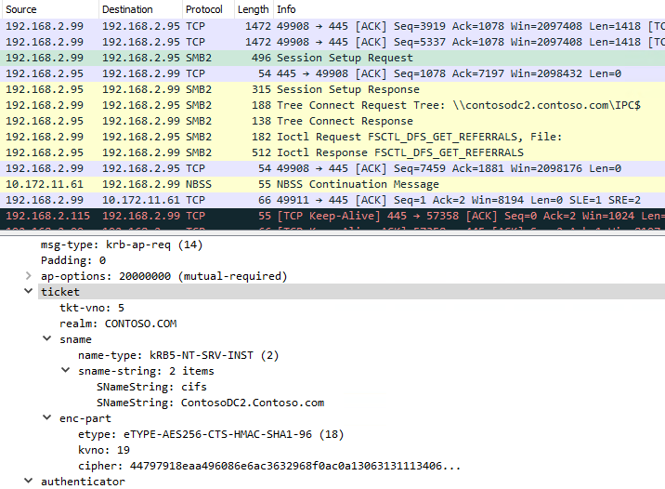
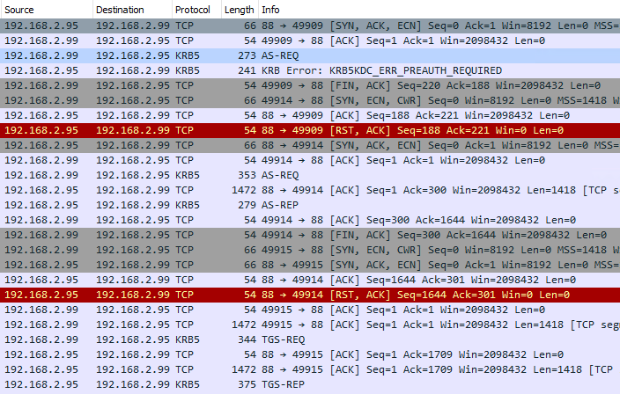
Demo
A simple AS -> TGS -> AP process

Slide 15
Troubleshooting

Slide 16
What to collect
Netmon trace
Auth ETW trace
https://internal.support.services.microsoft.com/en-us/help/4487175
Possible locations to collect
Client
DC(s)
Target server
Ref:
https://blogs.technet.microsoft.com/askds/2012/07/27/kerberos-errors-in-network-captures/
https://blogs.msdn.microsoft.com/openspecification/2011/05/30/windows-configurations-for-kerberos-supported-encryption-type/

Slide 17
How to collect
Stop application
Enable logging on related locations
Clear cached Kerberos tickets
klist purge
Klist -li 0x3e7 purge
Clear cached name resolution results
Ipconfig /flushdns
Reproduce the issue
Stop and save logs

Slide 18
How to analyze
Understand the symptom
Identify the ideal workflow, and determine where the problem could be
Capture logs at the corresponding locations
Analyze logs to narrow down the issue
Reach the root cause and solution, or revise the action plan and capture logs again

Slide 19
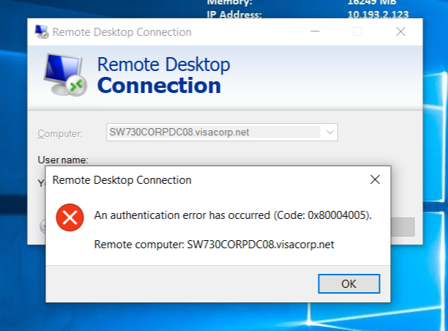
Case 1
Symptom: cannot RDP
Client and RDP server are in different forests

Slide 20
Case 1 - Discussion
What log to capture?
Where to capture?
How to capture?
Notes:
Capture netmon and auth ETW traces.
If Kerberos is used, it’s the client’s responsibility to get the ticket and then present it to the server. So start from the client.
Enable all logs, repro the issue, and then stop.

Slide 21
Case 1 - Kerberos ETW trace (1st time)
[3]03C8.22C4::07/22/19-12:59:09.0422151 [KERBEROS] SpInitLsaModeContext: Getting outbound ticket for TERMSRV/sw550visadc001.visa.com ((null))
[3]03C8.22C4::07/22/19-12:59:09.0422176 [KERBEROS] TargetInternalName TERMSRV/sw550visadc001.visa.com
[3]03C8.22C4::07/22/19-12:59:09.0422179 [KERBEROS] SpInitLsaModeContext getting service ticket
[3]03C8.22C4::07/22/19-12:59:09.0422240 [KERBEROS] Negative SPN cache entry located for name TERMSRV/sw550visadc001.visa.com
[3]03C8.22C4::07/22/19-12:59:09.0422243 [KERBEROS] and account realm AF.VISA.COM
[3]03C8.22C4::07/22/19-12:59:09.0422248 [KERBEROS] KerbGetSpnCacheStatus failed c000018b
[3]03C8.22C4::07/22/19-12:59:09.0422250 [KERBEROS] TargetName:
[3]03C8.22C4::07/22/19-12:59:09.0422265 [KERBEROS] TargetName TERMSRV/sw550visadc001.visa.com
[3]03C8.22C4::07/22/19-12:59:09.0422272 [KERBEROS] SpInitLsaModeContext failed to get outbound ticket, KerbGetServiceTicket <NULL> failed with 0xc000018b
[3]03C8.22C4::07/22/19-12:59:09.0422288 [KERBEROS] TargetInternalName TERMSRV/sw550visadc001.visa.com
[3]03C8.22C4::07/22/19-12:59:09.0422299 [KERBEROS] SpInitLsaModeContext returned 0xc000018b, Context 0000000000000000, Pid 0x0
[3]03C8.22C4::07/22/19-12:59:09.0422302 [KERBEROS] SpInitLsaModeContext returned 0xc000018b
…

Slide 22
Case 1 - Analyze
What does this line mean?
KerbGetSpnCacheStatus failed c000018b
Turns out it’s negative cache due to a previous failure to get ticket for the same SPN
So what to do next?
ETW trace since boot-up

Slide 23
Case 1 – Kerberos ETW trace (2nd time)
[1]0380.1C34::07/24/19-13:36:57.4593940 [KERBEROS] KerbMakeSocketCall uses KdcToCall option 0.
[1]0380.1C34::07/24/19-13:36:57.4594044 [KERBEROS] Retry #0 Calling kdc 10.179.110.25 for realm AF.VISA.COM, DesiredFlags 0, connection timeout: 0 secs
[1]0380.1C34::07/24/19-13:36:57.4594054 [kerbcomm] Calling KDC: 10.179.110.25
[2]0380.1C34::07/24/19-13:36:57.4605820 [kerbcomm] Successfully bound to 10.179.110.25
[2]0380.1C34::07/24/19-13:36:57.4606255 [kerbcomm] Socket being used for select is 0x1640
[3]0380.1C34::07/24/19-13:36:57.4618502 [kerbcomm] Socket being used for select is 0x1640
[3]0380.1C34::07/24/19-13:36:57.4619243 [CommonIumSafe] KerbUnpackData Asn1Err 0xfffffc0d
[3]0380.1C34::07/24/19-13:36:57.4619252 [KERBEROS] KerbGetTgsTicket failed to unpack KDC reply: 0x3c
[3]0380.1C34::07/24/19-13:36:57.4619343 [KERBEROS] KerbGetTgsTicket KDC error reply: 0x7, ExtendedStatus 0
[3]0380.1C34::07/24/19-13:36:57.4619416 [KERBEROS] TargetName TERMSRV/sw550visadc001.visa.com
[3]0380.1C34::07/24/19-13:36:57.4619422 [KERBEROS] KerbGetTgsTicket KerbCallKdc: error 0x7
[3]0380.1C34::07/24/19-13:36:57.4619515 [KERBEROS] Failed to get TGS ticket for service 0xc000018b
[3]0380.1C34::07/24/19-13:36:57.4619547 [KERBEROS] TargetName TERMSRV/sw550visadc001.visa.com
[3]0380.1C34::07/24/19-13:36:57.4619608 [KERBEROS] KerbGetServiceTicket by process 896, TARGET_UNKNOWN for AF.VISA.COM\admgpramkris LogonId 0:0xb99d9

Slide 24
Case 1 - Analyze
Why the DC 10.179.110.25 replied TARGET_UNKNOWN for the SPN TERMSRV/sw550visadc001.visa.com?
Which domain the DC belongs to?
Which domain the SPN belongs to?
Is that DC supposed to provide the ticket for that SPN?
What configuration is related to this behavior?

Slide 25
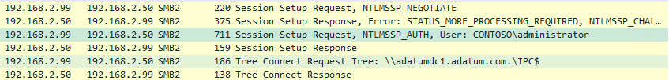
Case 2 – Cross-forest Kerberos failure
Symptom: See NTLM authentication in a cross-forest SMB session setup. Would like to understand why Kerberos was not used.

Slide 26
Case 2 - Discussion
What log to capture?
Where to capture?
How to capture?
Notes:
Capture netmon and auth ETW traces.
If Kerberos is used, it’s the client’s responsibility to get the ticket and then present it to the server. So start from the client.
Enable all logs, repro the issue, and then stop.

Slide 27
Case 2 – netmon trace from the client
Is AS working?
Is referral TGT working?
Is cross-forest TGS working?

Slide 28
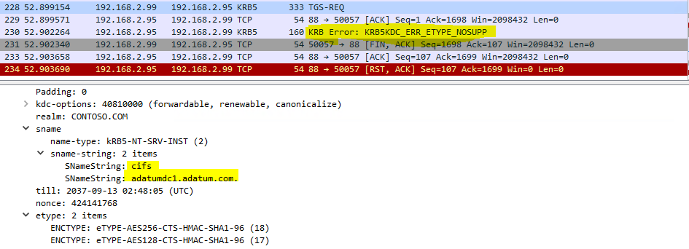
Case 2 – netmon trace from the client
Found error KRB5KDC_ERR_ETYPE_NOSUPP
What’s the possible cause?

Slide 29
Common errors

Slide 30
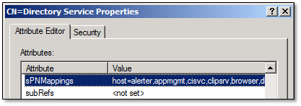
KDC_ERR_S_PRINCIPAL_UNKNOWN
That indicates the specified SPN is not available in AD.
Authentication may or may not fall back to NTLM, depending on the application.
What to check?
Setspn -q to search for SPN
Right domain/forest?
sPNMappings of HOST prefix at cn=Directory Services,CN=Windows NT,CN=Services,CN=Configuration,DC=[Your Domain Component]

Slide 31
KDC_ERR_C_PRINCIPAL_UNKNOWN
DC does not know which client principal it should use to encrypt the ticket.
What to check?
Missing UPN?
Duplicated UPN?

Slide 32
KDC_ERR_ETYPE_NOTSUPP
The client has requested a ticket from the domain controller with a specific algorithm of which the domain controller does not have a hash.
What to check?
What encryption protocols are suggested by the client? Check AS request.
What encryption protocols krbtgt account can use? Check msDS-SupportedEncryptionTypes of krbtgt account
What encryption protocols the related computers allow? Check policy Network Security: Configure Encryption types allowed for Kerberos, or registry entry HKEY_LOCAL_MACHINE\Software\Microsoft\Windows\CurrentVersion\Policies\System\Kerberos\Parameters\SupportedEncryptionTypes
AES not accepted by DC? Check if DFL >= W2K8.

Slide 33
KDC_ERR_PREAUTH_REQUIRED
Expected error if pre-authentication is required (by default)
Should be followed by pre-authentication

Slide 34
KDC_ERR_PREAUTH_FAILED
Pre-authentication failed
Wrong password, or missing user account?

Slide 35
KRB_AP_ERR_SKEW
Time synchronization issue

Slide 36
KRB_AP_ERR_MODIFIED
That indicates decryption failure.
Check if the SPN is registered under the correct service account.

Slide 37
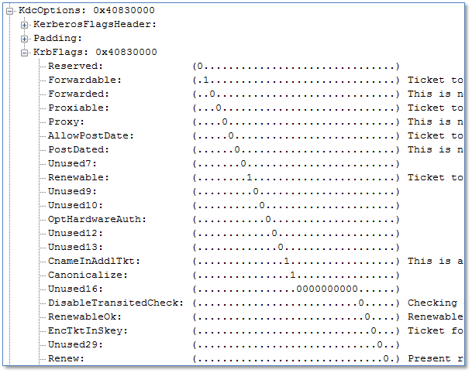
KDC_ERR_BADOPTION
One of more flags in KrbFlags is not accepted by DC
Study ETW trace from the KDC

Slide 38
Quiz
Re-iterate the troubleshooting logic of the 2 sample cases.
What’s the usage of a TGT ticket?
What’s the function of the group policy “Network Security: Configure Encryption types allowed for Kerberos”?
What’s the function of the attribute msDS-SupportedEncryptionTypes on user or computer account objects?
What’s the relationship between the 2 items in Q3 and Q4?

